Slide 1
Presentation on shaft sinking operation

Slide 2


Slide 3
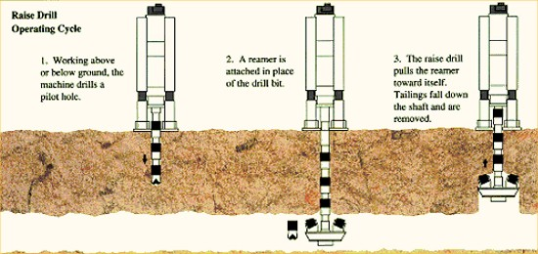
RAISE BORING
Rock conditions and their variability.
Very hard rock, their system is slow.

Slide 4
PARAMETERS FOR SOFT ROCK (European coal fields):-
Pilot hole diameter
Drill pipe diameter
Reaming Torque
Type of driver (AC, DC ,hydraulic)gear reducer
RPM
Power: Pilot hole thrust & feed rates reaming pull, size of drill pipe base plate and derrick dimensions, type of transporter, water and air consumption.
Dia /length/advance per unit time .
Costs reduced due development of improved cutters with average life being extended by fire fold.

Slide 5
PURPOSE
Ore passes
Ventilation
Ventilation shafts
Full sized shafts for coal mining.

Slide 6
ADVANTAGES:-
No worker needs to be present while excavation is on .
Cost thus gets reduced in (developed countries).
Faster progress.
Less damage to surrounding rock/thus minimum support is needed.
Smooth, stable walls, lead resistance for ventilation.

Slide 7
DISADVANTAGE:-
Change on rock conditions
Costs are high for hard rocks.
Access necessary.
Initial cost of rig is high.
Shaft should be dry.

Slide 8
OPERATION:-
Pilot hole then reaming in one or more stages.
Common is pilot hole down and reaming up.
SLUTCH COMPONENTS:-
Rig – Rigid plate and structure
Hydraulic, drilling and electrical equipment are housed

Slide 9
CRAWLER DRIVEN BY CA / RAILWHEELS:-
Pilot hole is drilled through the stem with stabilizers and a conventional drilling bit.
Drill rod diameter (20 -31 cm)
Length of the section is 1.5 m.
Purpose of stabiliser is to ensure directional accuracy of the pilot hole .
Stem longest /reamer-stages / structural analysis of required/balancing of tool by positioning cutters optimally.
Geared reamers/conventional type .
Best performance is achieved when cutter life and ROP are optimized.

Slide 10
Structural features- Ductility/Brittle abrasivity
Removal of cuttings (should be effective )
Reduce rocks layer of cuttings 40%
Drilling –air /water/foam/drilling fluid
D=W
Where D is DOP and W is applied load.
Reaming
RPM – wear/vibrations
Adequate room/interference with production
Drilling down/reaming up is the cheapest option.
Rock quality and its response can change the boring
direction.
Lining – strong rocks no lines/shotcret/rockbolt/± wire mesh/
steel lining.
Cost

Slide 11
Diameter | Length (move/min) | Mobilization (cost/move/m) | Setup (cost) | Pilot holes | Ream/m
3 m | 600/37 m | 58286/4436 | 29100/4500 | 28/12 | 81/47

Slide 12
KHERTI SHAFT DETAILS:-
Adit section : For exploitation of ore body above 424 MSL
Decline section: 5 mX3.25m size ,1 IN 9 from surface to364MSLand 306 MSL.
Production shaft section:424 MSL
PRODUCTION SHAFT:-
Upcast shaft-5.5 m dia
Concrete lined
Tower mounted 2870 KW 6 rope friction hoist with 2/14 t ships in counter balance.
Emergency escape and ladder way
Hoisting speed : 2 stages 1)8m/s 2)18 m/s

Slide 13
SERVICE SHAFT:-
Rectangular in shape
Size : 6.11m X 4.93m.
2 cage hoisting compartments.
Emergency escape cage & ladder way.
Double deck cages guided by rigid rail guides.
Shaft is provided with a steel head frame and is 1600 cylindrical double drum hoist with one drum clutched.

Slide 14
ORGANISATION OF SHAFT SINKING:-
Drilling + mucking/hoisting + lining
(shorter holes will take one cycle/shift)
Optimum would be the length that assures
a unit advance with minimum time taken.
Min. Cost principle ( Drilling of holes , Explosives, Mucking, Time taken).

Slide 15
Drilling Pattern :-
Accuracy in the shape of excavation.
Clean separation upto the desired depth.
Uniform fragmentation.
Minimum misfires(should be avoided).
Damage is controlled (nearby structures).

Slide 16
Pattern :-
Shape of the section
Rock strength.
Cleavage.
Dip of strata.
Water inflow.
Hole loading structure.

Slide 17
Cartridge | No. Of circles | Diameter of holes | Holes rate
32mm. | 3 | 0.37,0.66,0.93 | 1-2-3
 | 4 | 0.35,0.54,0.7,0.93 | 1-2-3-4
 | 5 | 0.27,0.43,0.6,0.93 | 1-2-3-4-5
45mm. | 3 | 0.3,0.6,0.95 | 1-3-6
 | 4 | 0.25,0.48,0.72,0.96 | 1-2-3-5

Slide 18
LINING IN SHAFTS
Factors:-
Type of lining.
Hydro geological conditions (geotechnical parameters).
Shaft function.
Planned life time.
Shape of shaft section.
Depth.
Availability of construction materials.
Construction cost .
Chemical activity.
Repairs and maintenance .

Slide 19
Temporary lining:-
Against falling rocks (6-40m)
Necessary when tech. is advancing
Permanent lining:-
Timber
Brick
Concrete blocks
Concrete monolithic
Reinforced concrete
Tubbrs (cast iron and pre cast elements)
Shotcrete (with wire mesh)
Anchor bolts (a combination some times)

Slide 20
1.Brick lining:-
Was popular /ability to carry load immediately /ease of repairs and resistance to corrosive factors.
2.Concrete block lining:-
Decreased seams
Higher strength
Less labour
Intensive in comparison to brick lining

Slide 21
3.Timber Lining:-
Seldom.
Disadvantage:-
Time and labour consuming
Low strength
High cost
Substantial permeability.

Slide 22
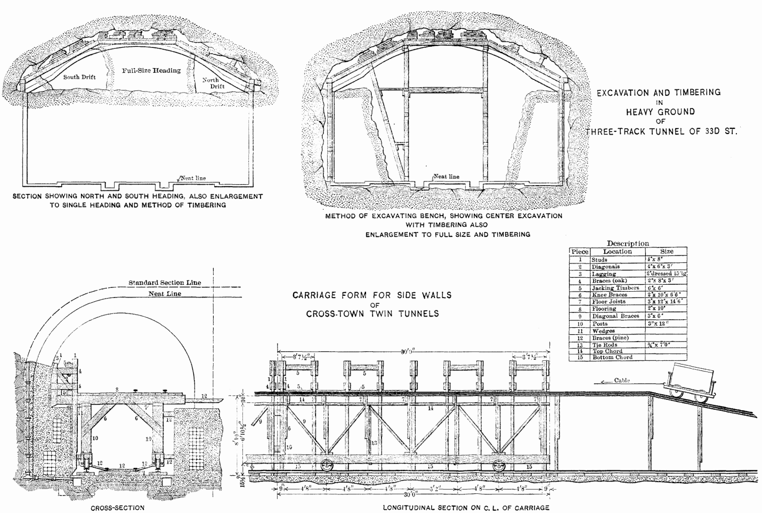
Timber Lining

Slide 23
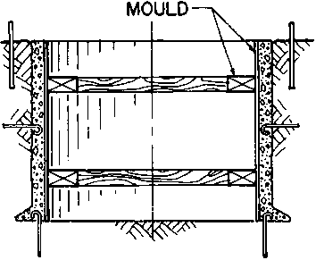
4.Monolithic concrete lining: –

Slide 24
Advantage:-
Complete mechanization possible.
Good bond between lining and shaft.
Decreased labour cost.
High strength.

Slide 25
Disadvantage:-
Less resistance to corrosive water
Sensitivity to rock mass movement
Inability to take load immediately
Difficult to repairs
Some facts-
17-25mp is sufficient
Min:200mm max:800mm
(4-5m)
Collapsible steel forms /segment with seam
Sliding type – longer segments

Slide 26
5.Shotcrete lining:-
Composition:-
Shotcrete
Shotcrete + rock bolts +mesh
RCC
RCC +bolts (temp. supports)
Applicable in dry shafts
Very good bonding
High strength to low water

Slide 27
{ t=r₀-r_{i ,} r = r₀-r_{i} }
σ_{t(max)}/F.S = 2P₀(t+r_{i})²/t(t+2r_{i})
P₀ = r h ( tan ^{r}(π/4-φ/2))
Φ = angle of internal friction
σ_{t} = (P₀r₀²/(r₀²-r_{i}²))((1+r_{i}²)/r₀²)
= 2P₀r₀²
σ_{t} = (P₀)((r₀=r_{i})²-2r₀r_{i})/(r₀+r_{i})(r₀-r_{i})
=P₀(r₀+r_{i})/(r₀-r_{i})-(2P₀r₀r_{i})/(r₀²-r­_{i}²)

Slide 28
Primary Stresses:-
σ_{r}=∑rh
h=thickness of rock stratum
for 500 σ_{r}/σ_{t}=2to 3
Polyethylene –membrance to prevent corrosive waters.
The following are the three categories
Cohesion less
Cohesive
Rocks

Slide 29
σ_{r} = p₀
σ_{t} = 2p_{0 .} r_{o}² / r₀² - r_{i}²
σ_{t max} / F.S = 2p_{0 .} (t+r_{i})² / (r₀ - r_{i} )( r₀ + r_{i})
= 2p_{0 .} (t+r_{i})² / (t)( r₀ + r_{i})
σ_{t max} / F.S = 2p_{0 .} (t+r_{i})² / (t)( t +2 r_{i})
t = { ( σ_{t max} / F.S )/( σ_{t max} /F.S – 2.p_{o} ) - 1 }
σ_{t max} = 0.67 fcu.
P₀

Slide 30
fcu : Cube strength of concrete after 28 days
(British standard code )
r_{f} : for applied load
r_{m} : different srength in concrete
(due in sufficient copaction & difference in curving ).
r_{m} = 1.5 and r_{f} = 1.4
0.67/1.4 x1.5 = 2x0.01xd(t+r_{i})² / (t)( t +2 r_{i})
.: t =r_{i} [ (0.67fcu/2.1)/(0.67fcu/2.1 – 2x0.01d)} - 1]
d in mts , r_{i} in mts , t in mm and fcu in N/mm²

Slide 31
Some Points :-
Support of Shaft equipment and walls .
Shallow square (timber support).
Deep circular or spherical.
Concrete lining mostly – mechanized/utilizes the structure features of concrete, easy least air flow resistance.
Strengths 20 to 50 Mpa .
Cast iron tubbings with concrete mantle welded steel lining (water heads).

Slide 32
Bitumen envelop for preventing damage due to subsiding strata.
Temporary support fos = 1.
Permanent fos > 1 (lining conditions and life space ).
Primary stress σ _{v} = Σ γ h.
σ _{h} /σ _{v} = 2 to 3 < 500m depth .
σ_{h­} = σ_{v} . K_{a} K_{a} : co efficient of active stress.
Stress distribution around shaft existing cracks , shaft diameter ,method of (D and B or boring ),time of exposure without support type of temp. Support used and delay instead of permanent lining .

Slide 33
σ_{h­} = σ_{v} . K_{a} K_{a} : co efficient of active stress.
Polyethylene membrane for preventing corrosion of concrete for water insulation.
RMR and Q → K_{a­} ( Horizontal design stress).
Un supported span ( 15 – 25 m).
ThanK YoU

